Slide 1


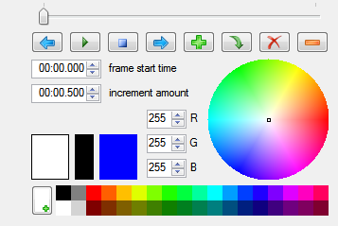
Enhanced Animation Canvas
Control Panel
Grid
Motion
Menu
Save State Menu

